Slide 1
Image Compression

Slide 2
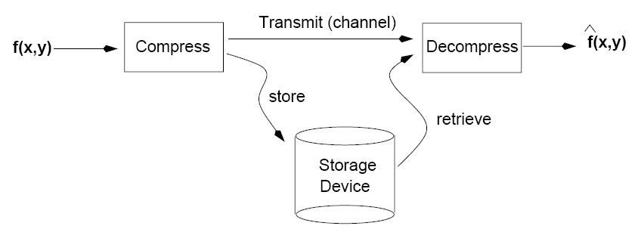
Goal of Image Compression
The goal of image compression is to reduce the amount of data required to represent a digital image.

Slide 3
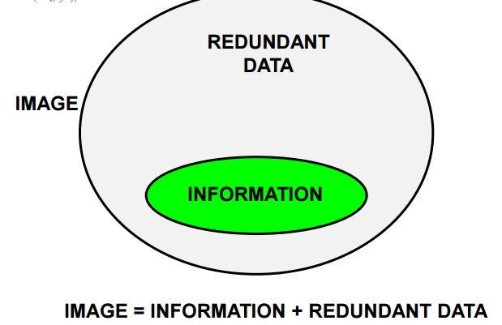
Data ≠ Information
Data and information are not synonymous terms!
Data is the means by which information is conveyed.
Data compression aims to reduce the amount of data required to represent a given quantity of information while preserving as much information as possible.

Slide 4
Data vs Information (cont’d)
The same amount of information can be represented by various amount of data, e.g.:
Ex1:
Your wife, Helen, will meet you at Logan Airport in Boston at 5 minutes past 6:00 pm tomorrow night
Your wife will meet you at Logan Airport at 5 minutes past 6:00 pm tomorrow night
Helen will meet you at Logan at 6:00 pm tomorrow night
Ex2:
Ex3:

Slide 5

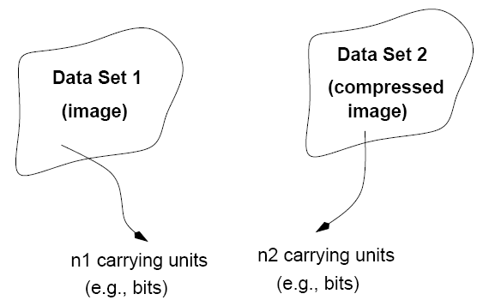
Definitions: Compression Ratio
compression
Compression ratio:

Slide 6
Definitions: Data Redundancy
Relative data redundancy:
Example:

Slide 7
Types of Data Redundancy
(1) Coding Redundancy
(2) Interpixel Redundancy
(3) Psychovisual Redundancy
Compression attempts to reduce one or more of these redundancy types.

Slide 8
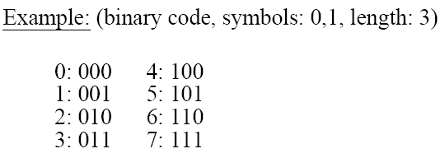
Coding Redundancy
Code: a list of symbols (letters, numbers, bits etc.)
Code word: a sequence of symbols used to represent a piece of information or an event (e.g., gray levels).
Code word length: number of symbols in each code word
Notes:
8

Slide 9
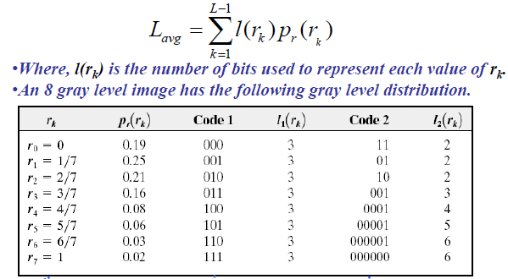
Coding Redundancy
Average number of bits required to represent each pixel is given by:

Slide 10
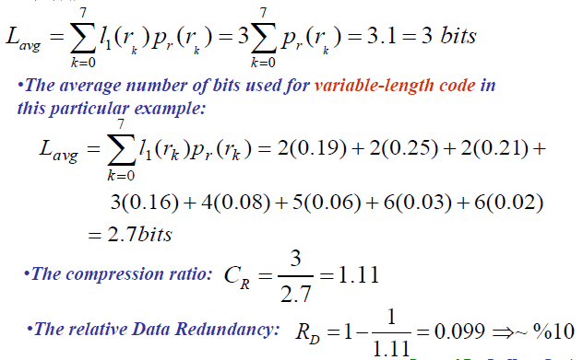
Coding redundancy
The average number of bit used for fixed 3-bit code:

Slide 11
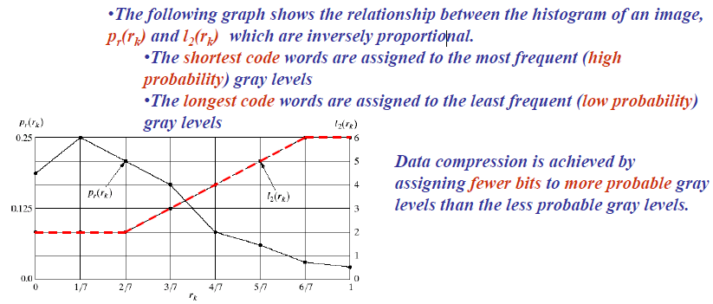

Slide 12
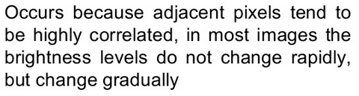
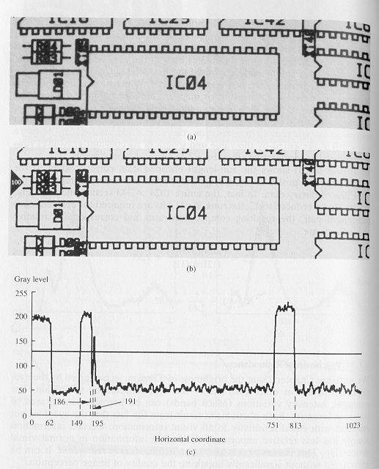
Inter pixel redundancy
(profile – line 100)
original
threshold
thresholded

Slide 13
Psycho-visual Redundancy
Certain information has relatively less importance for the quality of image perception. This information is said to be psychovisually redundant.
Unlike coding and interpixel redundancies, the psychovisual redundancy is related with the real/quantifiable visual information. Its elimination results a loss of quantitative information. However psychovisually the loss is negligible.
Removing this type of redundancy is a lossy process and the lost information cannot be recovered.
The method used to remove this type of redundancy is called quantization which means the mapping of a broad range of input values to a limited number of output values.

Slide 14
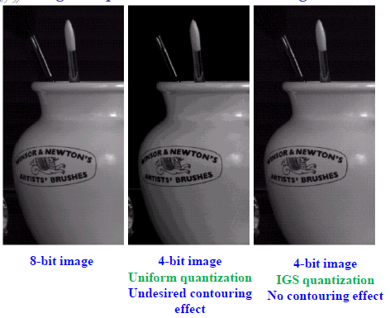

Slide 15
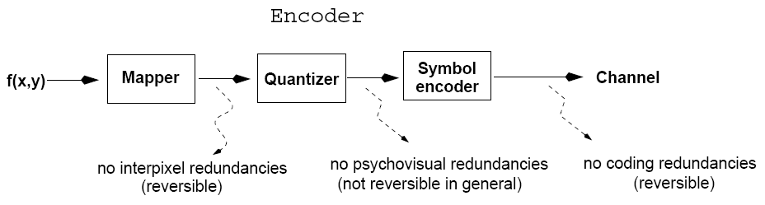
Image Compression Model (cont’d)
Mapper: transforms input data in a way that facilitates reduction of interpixel redundancies.

Slide 16
Image Compression Model (cont’d)
Quantizer: reduces the accuracy of the mapper’s output in accordance with some pre-established fidelity criteria.
Notes:
16

Slide 17
Image Compression Model (cont’d)
Symbol encoder: assigns the shortest code to the most frequently occurring output values.
Notes:
17

Slide 18
Image Compression Models (cont’d)
Inverse steps are performed.
Note that quantization is irreversible in general.

Slide 19
Fidelity Criteria
How close is to ?
Criteria
Subjective: based on human observers
Objective: mathematically defined criteria
Notes:
19

Slide 20
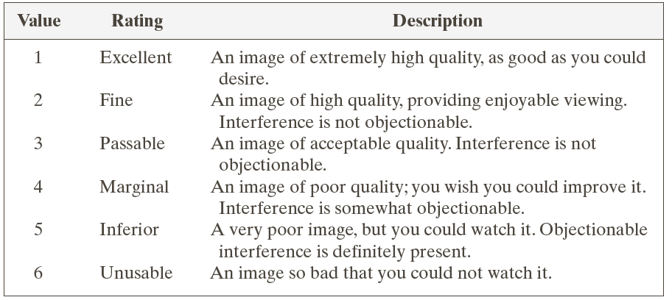
Subjective Fidelity Criteria

Slide 21
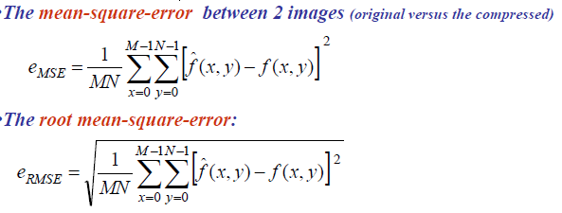
Quality Measure of a Compressed Image (Fidelity Criteria):
The quality of such images can be evaluated by objective and subjective methods.
The objective quality measures:

Slide 22
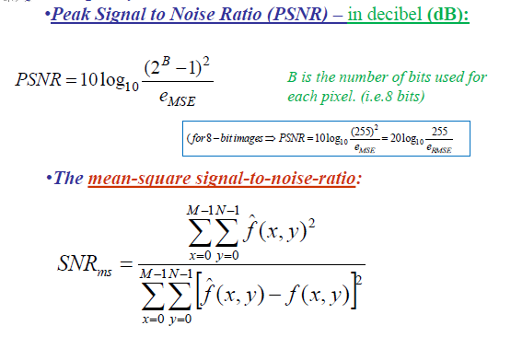

Slide 23
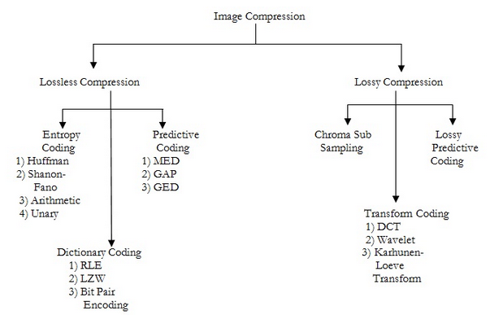
Compression Methods

Slide 24
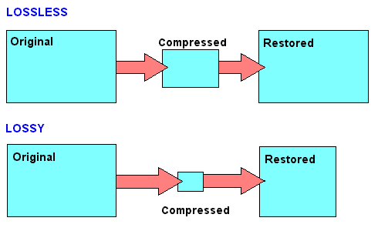
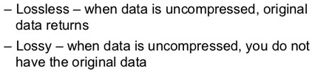
Lossless Vs Lossy

Slide 25
Entropy Coding
Average information content of an image:
Average information content of an image:
using
Entropy:
units/pixel
(e.g., bits/pixel)

Slide 26
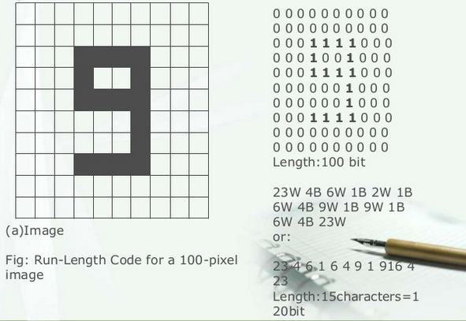
Run Length Coding

Slide 27
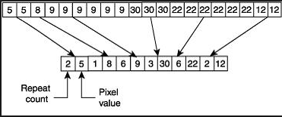
Run Length Coding

Slide 28
Huffman Encoding
A = 0 B = 100 C = 1010 D = 1011 R = 11
ABRACADABRA = 01001101010010110100110
This is eleven letters in 23 bits
A fixed-width encoding would require 3 bits for five different letters, or 33 bits for 11 letters
Notice that the encoded bit string can be decoded!

Slide 29
Why it works
In this example, A was the most common letter
In ABRACADABRA:
5 As code for A is 1 bit long
2 Rs code for R is 2 bits long
2 Bs code for B is 3 bits long
1 C code for C is 4 bits long
1 D code for D is 4 bits long

Slide 30
Creating a Huffman encoding
For each encoding unit (letter, in this example), associate a frequency (number of times it occurs)
You can also use a percentage or a probability
Create a binary tree whose children are the encoding units with the smallest frequencies
The frequency of the root is the sum of the frequencies of the leaves
Repeat this procedure until all the encoding units are in the binary tree

Slide 31

Example, step I
Assume that relative frequencies are:
A: 40
B: 20
C: 10
D: 10
R: 20
(I chose simpler numbers than the real frequencies)
Smallest number are 10 and 10 (C and D), so connect those

Slide 32
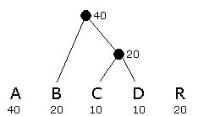
Example, step II
C and D have already been used, and the new node above them (call it C+D) has value 20
The smallest values are B, C+D, and R, all of which have value 20
Connect any two of these

Slide 33
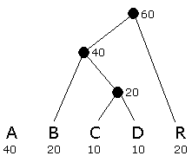
Example, step III
The smallest values is R, while A and B+C+D all have value 40
Connect R to either of the others

Slide 34
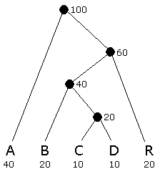
Example, step IV
Connect the final two nodes

Slide 35
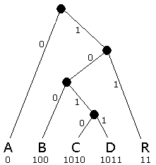
Example, step V
Assign 0 to left branches, 1 to right branches
Each encoding is a path from the root
A = 0 B = 100 C = 1010 D = 1011 R = 11
Each path terminates at a leaf
Do you see why encoded strings are decodable?

Slide 36
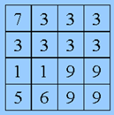
Example 2:

Slide 37
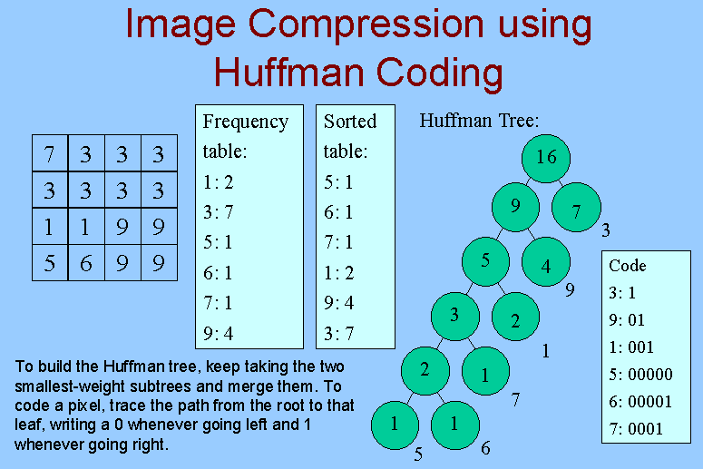

Slide 38
Practical considerations
It is not practical to create a Huffman encoding for a single short string, such as ABRACADABRA
To decode it, you would need the code table
If you include the code table in the entire message, the whole thing is bigger than just the ASCII message
Huffman encoding is practical if:
The encoded string is large relative to the code table, OR
We agree on the code table beforehand
For example, it’s easy to find a table of letter frequencies for English (or any other alphabet-based language)

Slide 39
Shanon-Fano Coding:
Sort the source symbols with their probabilities in a decreasing order.
Divide the full set of symbols into 2 parts such that each part has an equal or approximately equal probability.
Code the symbols in the first part with bit 0, and the symbols in the second part with bit 1.
Continue the process recursively until each block has only one symbol in it.

Slide 40
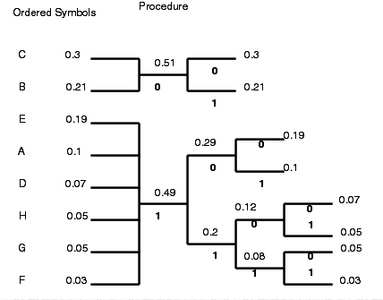
Example:
Symbol | Codeword
C | 00
B | 01
E | 100
A | 101
D | 1100
H | 1101
G | 1110
F | 1111

Slide 41
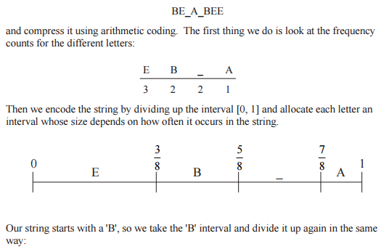
Arithmetic Coding

Slide 42
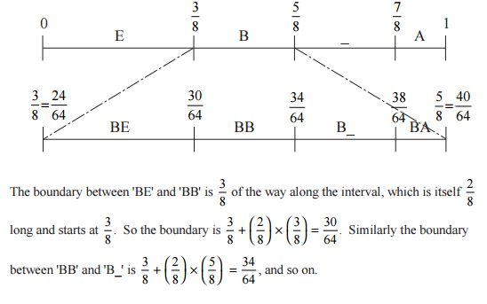

Slide 43
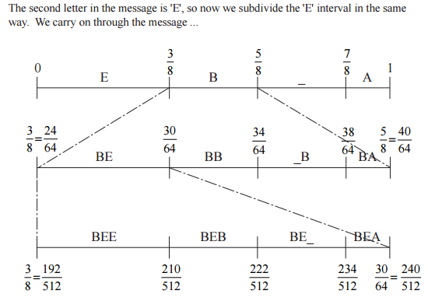
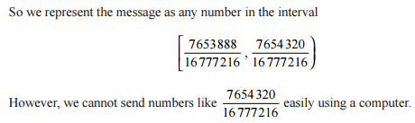

Slide 44
LZW Compression
LZW compression is the compression of a file into a smaller file using a table-based lookup algorithm invented by Abraham Lempel, Jacob Ziv, and Terry Welch.

Slide 45
When the LZW program starts to encode a file, the code table contains only the first 256 entries, with the remainder of the table being blank.
This means that the first codes going into the compressed file are simply the single bytes from the input file being converted to 12 bits.
As the encoding continues, the LZW algorithm identifies repeated sequences in the data, and adds them to the code table.
Compression starts the second time a sequence is encountered.
The key point is that a sequence from the input file is not added to the code table until it has already been placed in the compressed file as individual characters (codes 0 to 255). This is important because it allows the uncompression program to reconstruct the code table directly from the compressed data, without having to transmit the code table separately.

Slide 46
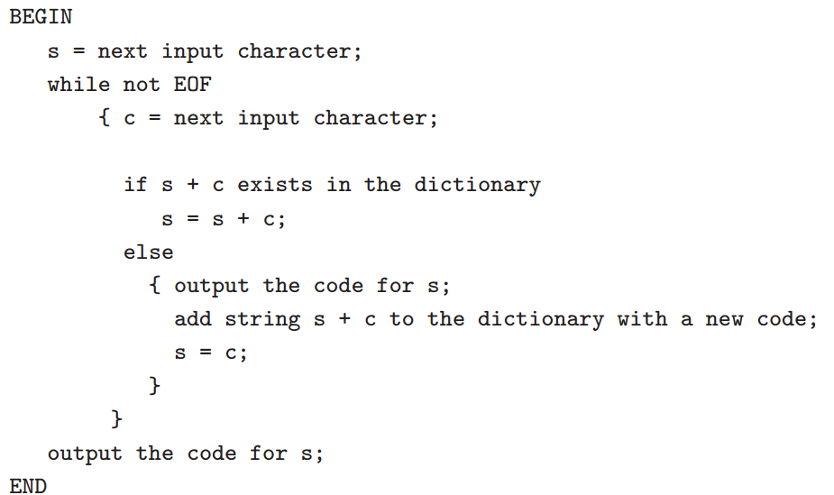
LZW: Algorithm

Slide 47
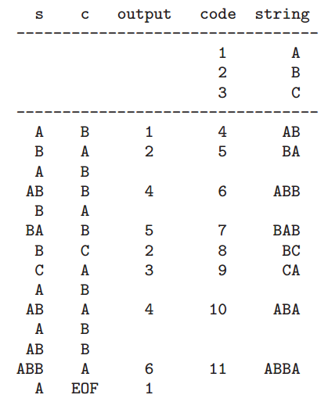
LZW compression algorithm: “ABABBABCABABBA” -- example
The output codes are: 1 2 4 5 2 3 4 6 1. Instead of sending 14 characters, only 9 codes need to be sent (compression ratio = 14/9 = 1.56).

Slide 48
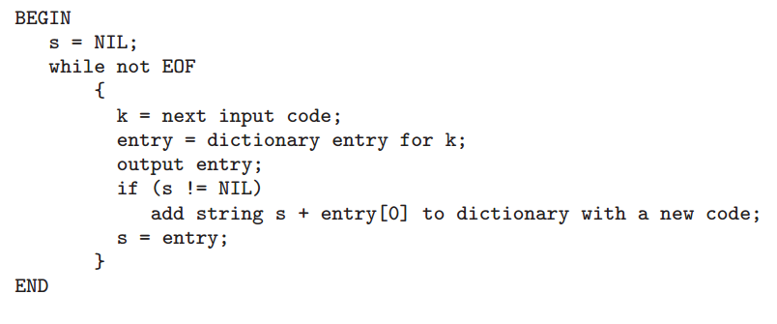
LZW: Decompression

Slide 49
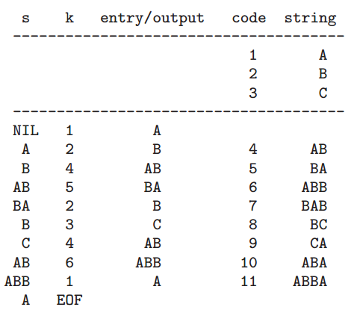
1 2 4 5 2 3 4 6 1
Input:
A B AB BA B C AB ABB A
Final Result: A B AB BA B C AB ABB A

Slide 50
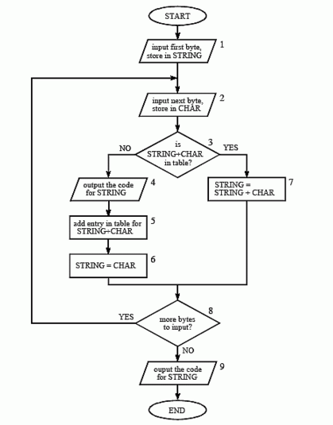

Slide 51
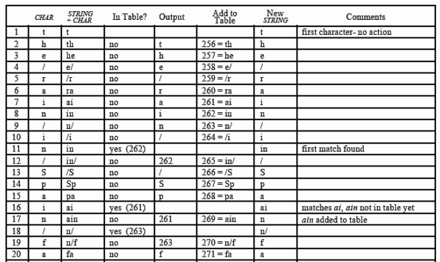
Example: 45 bytes of the ASCII text string: the/rain/in/Spain/falls/mainly/on/the/plain.

Slide 52
